Slide 1

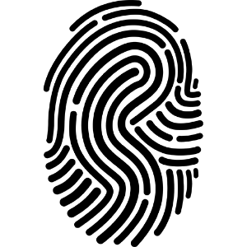
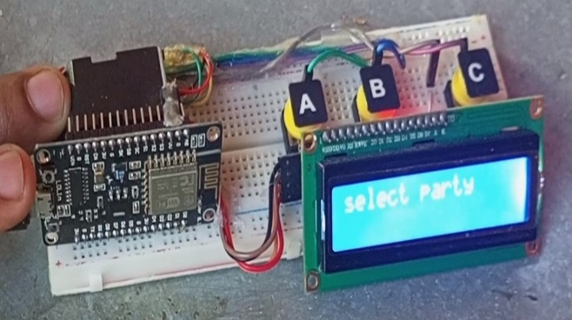
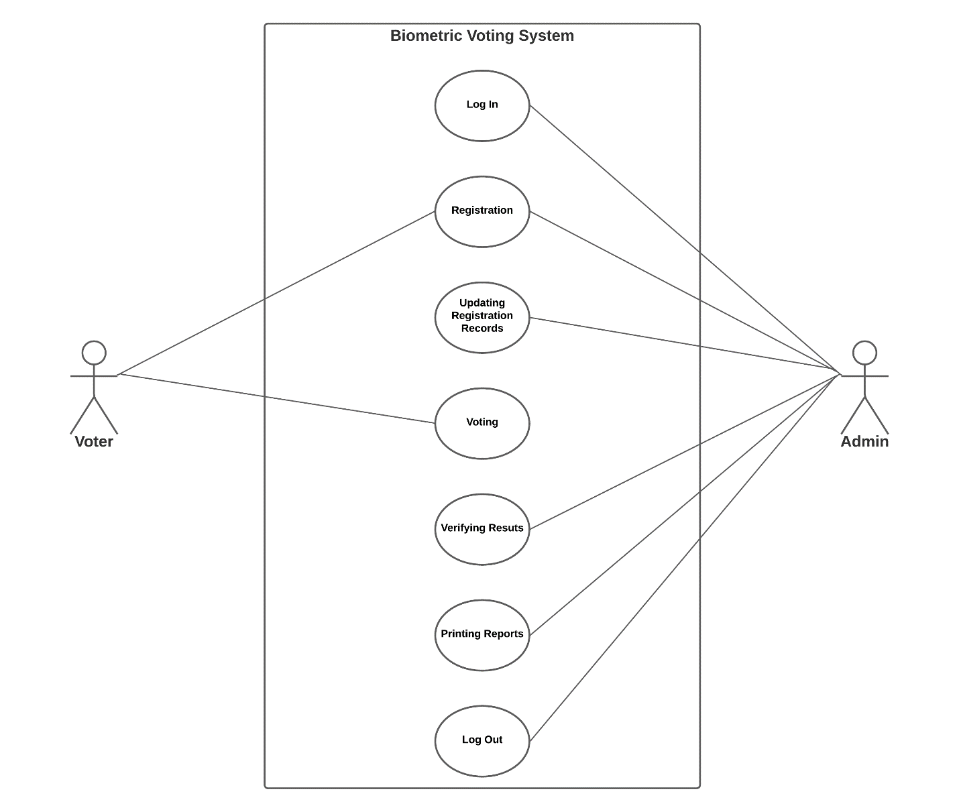
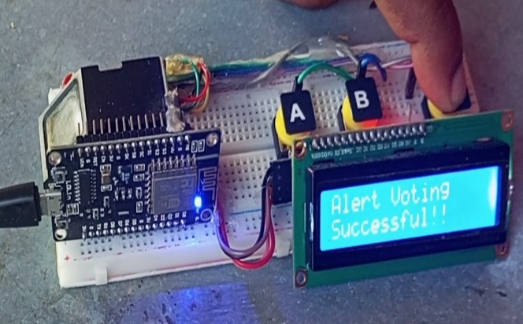
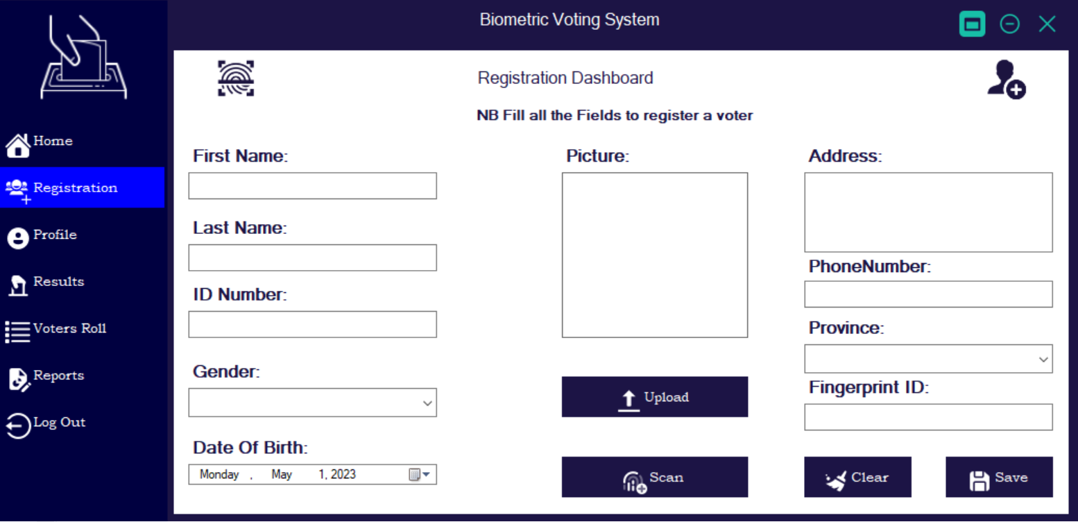
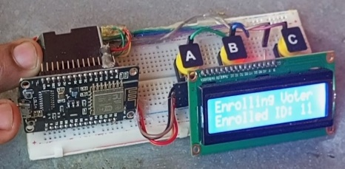
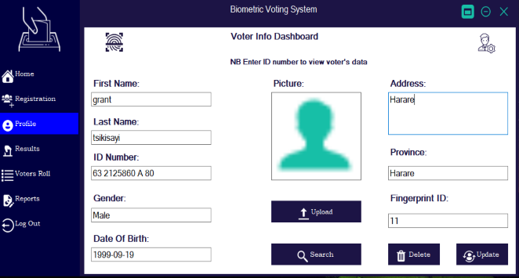
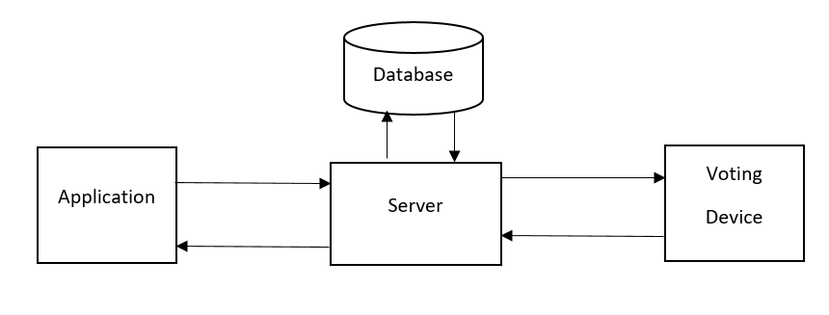
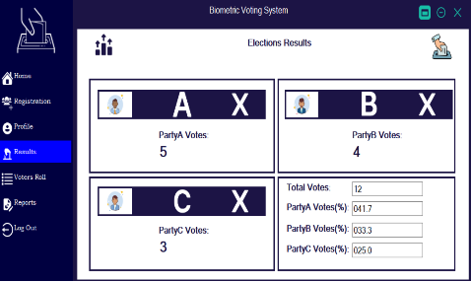
BIOMETRIC VOTING SYSTEM
Grant T Tsikisayi HI90306Z - Software Engineering Department
1.0 Abstract
3.0. Problem definition
7.0. Use Case Diagram
Voting enables citizens to express their opinions and participate in the creation of a democratic government; therefore, the procedure should be trustworthy, accurate, and transparent. A voter's vote cannot be counted in the majority of countries unless they cast a paper ballot and place it in a voting box. Most people claim to have participated in numerous manipulated elections. To solve these issues, I suggest using fingerprints as a form of electronic voter identification. Voting machines will be used by registered voters to cast their ballots. The suggested model allows for the use of fingerprints to count votes. The voting device will be connected to the system via IOT technology. The technique employs fingerprints to uniquely identify voters because each person's fingerprints have a unique pattern. As a result, it would be preferable to the current voting procedures. During an election, a voter's fingerprint is entered into the system. Then, this is compared to the records that are already in the database. If the precise pattern matches anyone in the database, voting rights are granted. However, if the pattern does not match the database records or if there is recurrence, authorization to vote is denied or the vote is disregarded. A network that connects each and every voting machine transmits data to the main host. The result is immediate, and the primary host is used for the final tally. Election-related expenses as a whole drop, as does the cost of keeping the systems running. This concept is proposed by considering the current electoral procedure norms. Therefore, migrating to this system can be very easy.
In the majority of nations, the ensuing problems can happen because voting must be done manually and on paper, which is costly and time-consuming.
Using the gaps, it might allow unregistered voters to cast votes in their favor.
It takes a lot of time and is difficult to recount the ballots when there are questions because the votes are manually counted.
Too much paper is consumed in the process, and because it gets heavier as the population rises, it is difficult to store the paper.
Voting and vote-counting mistakes: When a voter chooses two or more candidates, it might be difficult to count the votes and mistakes can happen during the voting process. Another scenario is when there are too many votes, which makes losing track of the totals easier.
.
4.0. Overview of the developed application
With the proposed model, a voter's vote can be counted using fingerprints. IOT technology will be used to connect the voting gadget to the system. Given that each person's fingerprints have a distinct pattern, the system uses them to uniquely identify voters. It would therefore be superior to the voting systems in use today. A voter's fingerprint is input into the system during an election. The records that are present in the database are then compared to this. Voting privileges are made available if the specific pattern matches anyone in the database. However, permission to cast a vote is refused or the vote is rejected if the pattern does not match the database records or if there is repetition. Data is transferred to the primary host through a network that connects each and every voting machine.
8.0. Screenshots
Conclusion
2.0. Introduction
Finger print is considered as one of the most popular biometric method used for human recognition. Every recognition in the globe is or with unique fingerprint and even twins are born with totally different finger print and is naturally unchangeable throughout the life. For that reason finger print voting system has been made and person ID has been replaced with finger print. This finger print voting system is evaluated and implemented successfully. The evaluation of the system is made using different PC’s with different specifications in order to stand on the system strength and weakness. The final result of finger print voting system is significant and compatible with other voting systems.
Voting allows people to voice their thoughts and take part in the formation of a democratic government; as a result, the process should be reliable, accurate, and open. In the majority of nations, a voter's vote cannot be counted unless they cast a paper ballot and deposit it in a voting box. The vast majority of people allege that they took part in multiple rigged elections. I propose employing fingerprints as a method of electronic voter identification to address these problems. Registered voters will be able to cast their ballots using a voting machine. The Biometric Voting System uses fingerprint recognition technology to cast votes for specific individuals. A voter's on-site fingerprint can be taken and used as identification by simply placing a finger on the device at the polling place. If it is discovered in the data kept at voter registration, the information is sent for verification, and the person is then given the right to cast a ballot.
5.0. Objectives
To construct a voting machine.
To use fingerprints as a unique ID for voters.
To count votes automatically
To produce reports of voting results.
To make the voter’s vote anonymous.
Supervisor – Mrs Zindove
6.0. System Overview

